Slide 1
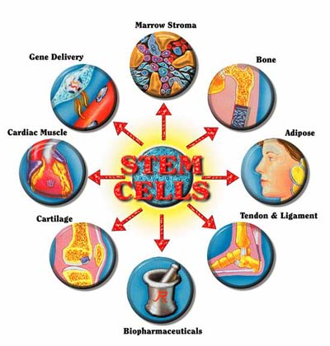
Stem Cell Background

Slide 2
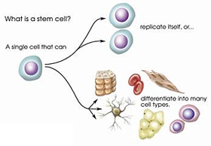
What are they?
“Stem cells are universal cells that have the ability to develop into specialized types of tissues that can then be used throughout the body to treat diseases or injuries.”

Slide 3
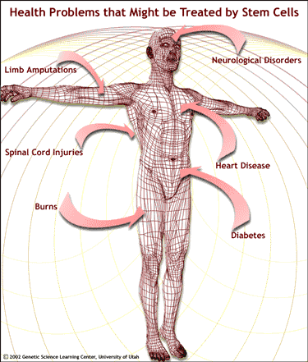
What can they do?
Scientists hope that one day they will be used to grow new organs such as kidneys or spinal cords as well as different types of tissues such as nerves, muscles, and blood vessels.
Could be used to treat diseases.

Slide 4
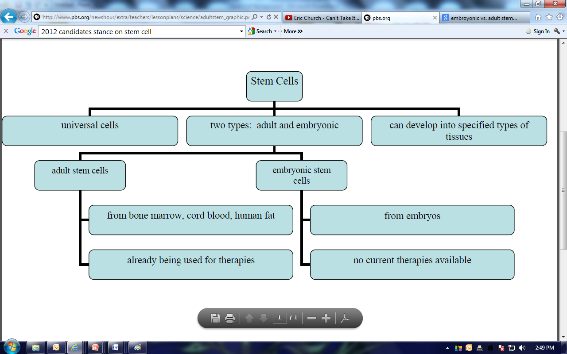
Embryonic vs. Somatic/Adult

Slide 5
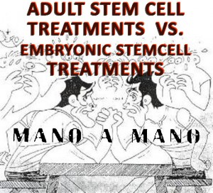
Why so controversial?
The controversy of the use of stem cells and research in this area comes from the fact that many people support the use of embryonic stem cells for research.
These cells are taken from embryos that are just days old.
As a result of this, the embryo, is destroyed.
Many people feel it is immoral and unethical to destroy embryos for the sake of science.

Slide 6
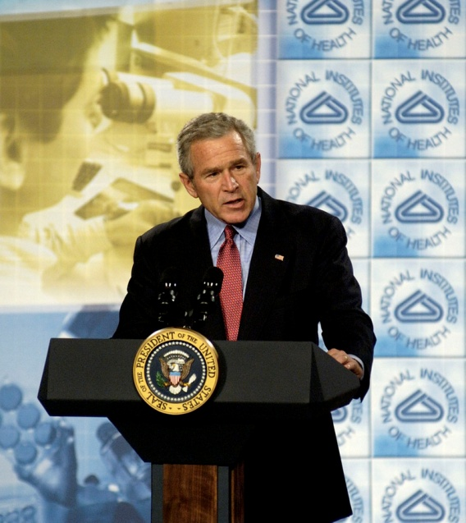
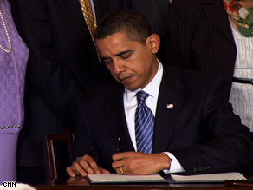
Why so controversial?
Where does the money/funding come from?
Legislative ban in 1996 on taxpayer money used on work that harms an embryo.

Slide 7
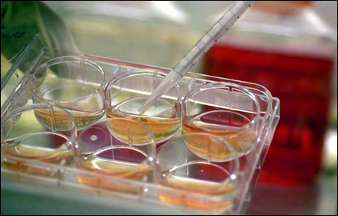
Why so controversial?
Where does the money/funding come from?
2001- President Bush limited research to 21 existing lines of stem cells.
2009- President Obama lifts ban
“Executive Order 13505 - Removing Barriers to Responsible Scientific Research Involving Human Stem Cells”

Slide 8
Discussion Should Stem Cells be used and researched or not?
 | Levels of Performance
Criteria | 1 | 2 | 3 | 4
1. Organization and Clarity: viewpoints and responses are outlined both clearly and orderly. | Unclear in most parts | Clear in some parts but not over all | Most clear and orderly in all parts | Completely clear and orderly presentation
2. Use of Arguments: reasons are given to support viewpoint. | Few or no relevant reasons given | Some relevant reasons given | Most reasons given: most relevant | Most relevant reasons given in support
3. Use of Examples and Facts: examples and facts are given to support reasons. | Few or no relevant supporting examples/facts | Some relevant examples/facts given | Many examples/facts given: most relevant | Many relevant supporting examples and facts given
4. Use of Rebuttal: arguments made by the other teams are responded to and dealt with effectively. | No effective counter-arguments made | Few effective counter-arguments made | Some effective counter-arguments made | Many effective counter-arguments made
5. Presentation Style: tone of voice, use of gestures, and level of enthusiasm are convincing to audience. | Few style features were used; not convincingly | Few style features were used convincingly | All style features were used, most convincingly | All style features were used convincingly

